Slide 1
NEONATAL JAUNDICE
Dr.K.L.Chaitanya
Asst.professor
paediatrics

Slide 2
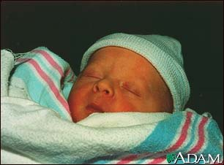
What is the Neonatal Jaundice?
Neonatal Jaundice(also called Newborn jaundice) is a condition marked by high levels of bilirubin in the blood.
The increased bilirubin cause the infant's skin and whites of the eyes (sclera) to look yellow.

Slide 3
NJ - 3
Neonatal Jaundice
Visible form of bilirubinemia
Adult sclera >2mg / dl
Newborn skin >5 mg / dl
Occurs in 60% of term and 80% of preterm neonates
However, significant jaundice occurs in 6 % of term babies
Teaching Aids: NNF
Notes:
3

Slide 5
Special characteristic in neonates
1.More billirubin produced
Much more Hemolysis
The life-length of hemolysis(70~80)

Slide 6
Special characteristic in neonates
2.The low capability of albumin on unconjugated billirubin transportation
acid intoxication
Less albumin in neonates

Slide 7
Special characteristic in neonates
3.The low capability of heptatocyte
Less Y protein and Z protein
The primary development of Hepato-enzyme system
Easy-broken hepato-enzyme system
After-born, the blood glucose level is very low.

Slide 8
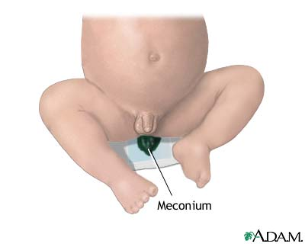
Special characteristic in neonates
4.High workload of the hepato-enteric circulation
Less bacterial
Low enzymatic activity in intestine
High level of billirubin in
meconium

Slide 9
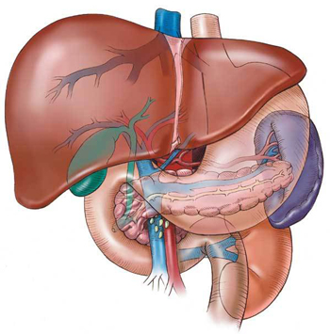
A little exam
Increased rbc’s
Shortened rbc lifespan
Immature hepatic uptake & conjugation
Increased enterohepatic
Circulation

Slide 10
Grading of extent of jaundice 2

Slide 11
NJ - 11
Clinical assessment of jaundice
Area of body Bilirubin levels mg/dl
Face 4-8
Upper trunk 5-12
Lower trunk & thighs 8-16
Arms and lower legs 11-18
Palms & soles > 15
Teaching Aids: NNF
Notes:
11

Slide 12
NJ - 12
Physiological jaundice
Characteristics
Appears after 24 hours
Maximum intensity by 4th-5th day in term & 7th day in preterm
Serum level less than 15 mg / dl
Clinically not detectable after 14 days
Disappears without any treatment
Note: Baby should, however, be watched for worsening of jaundice
Teaching Aids: NNF
Notes:
12

Slide 13
NJ - 13
Pathological jaundice
Appears within 24 hours of age
Increase of bilirubin > 5 mg / dl / day
Serum bilirubin > 15 mg / dl
Jaundice persisting after 14 days
Stool clay / white colored and urine staining clothes yellow
Direct bilirubin> 2 mg / dl
Teaching Aids: NNF
Notes:
13

Slide 14
NJ - 14
Causes of jaundice
Appearing within 24 hours of age
Hemolytic disease of NB : Rh, ABO
Infections: TORCH, malaria, bacterial
G6PD deficiency
Appearing between 24-72 hours of life
Physiological
Sepsis
Polycythemia
Concealed hemorrhage
Intraventricular hemorrhage
Increased entero-hepatic circulation
Teaching Aids: NNF
Notes:
14

Slide 15
NJ - 15
Causes of jaundice
After 72 hours of age
Sepsis
Cephalhaematoma
Neonatal hepatitis
Extra-hepatic biliary atresia
Breast milk jaundice
Metabolic disorders
Teaching Aids: NNF
Notes:
15

Slide 16
NJ - 16
Common causes in India
Physiological
Blood group incompatibility
G6PD deficiency
Bruising and cephalhaematoma
Intrauterine and postnatal infections
Breast milk jaundice
Teaching Aids: NNF
Notes:
16

Slide 17
NJ - 17
Approach to jaundiced baby
birth weight
gestation and postnatal age
Assess clinical condition (well or ill)
physiological or pathological
Look for evidence of kernicterus* in deeply jaundiced NB
*Lethargy and poor feeding, poor or absent Moro's, opisthotonus or convulsions
Teaching Aids: NNF
Notes:
17

Slide 18
NJ - 18
Workup
Maternal & perinatal history
Physical examination
Laboratory tests (must in all)*
Total & direct bilirubin*
Blood group and Rh for mother and baby*
Hematocrit, retic count and peripheral smear*
Sepsis screen
Liver and thyroid function
TORCH titers, liver scan when conjugated hyperbilirubinemia
Teaching Aids: NNF
Notes:
18

Slide 20
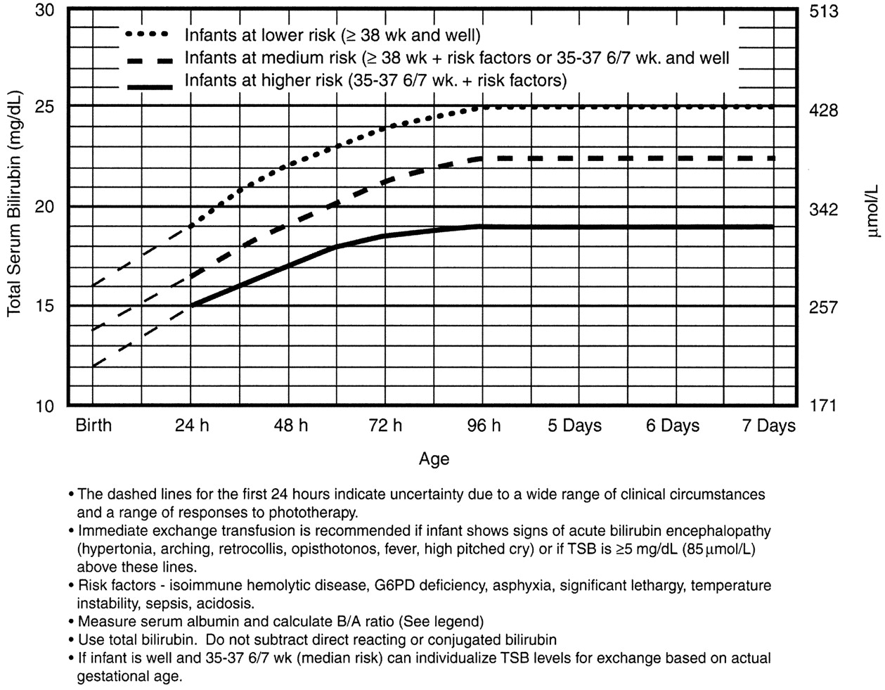

Slide 21
NJ - 21
Management
Rationale: reduce level of serum bilirubin and prevent bilirubin toxicity
Prevention of hyperbilirubinemia: early feeds, adequate hydration
Reduction of bilirubin levels: phototherapy, exchange transfusion, drugs
Teaching Aids: NNF
Notes:
21

Slide 22
NJ - 22
Principle of phototherapy
Native bilirubin Photo isomers of bilirubin
Insoluble Soluble
450-460nm
of light
Teaching Aids: NNF
Notes:
22

Slide 23
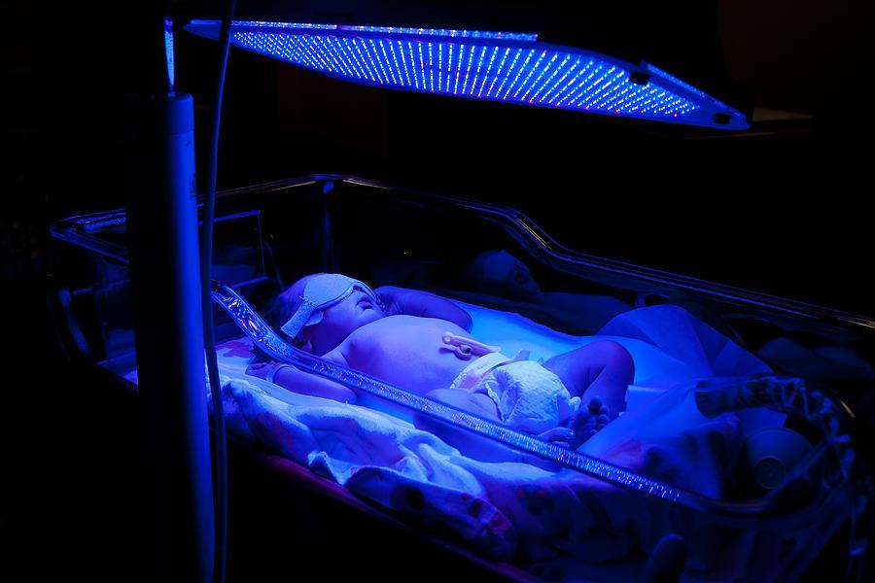

Slide 24
NJ - 24
Phototherapy equipment
White light tubes 6-8*/ 4 blue light tubes
Cradle or incubator
Eye shades
*May use 150 W halogen bulb
Teaching Aids: NNF
Notes:
24

Slide 25
NJ - 25
Phototherapy
Technique
Perform hand wash
Place baby naked in cradle or incubator
Fix eye shades
Keep baby at least 45 cm from lights, if using closer monitor temperature of baby
Start phototherapy
Teaching Aids: NNF
Notes:
25

Slide 26
NJ - 26
Phototherapy
Frequent extra breast feeding every 2 hourly
Turn baby after each feed
Temperature record 2 to 4 hourly
Weight record- daily
Monitor urine frequency
Monitor bilirubin level
Teaching Aids: NNF
Notes:
26

Slide 27
Key point in the practical execution of phototherapy
1-The infant should be naked except for diaper , eye to be covered
2- distance between the skin and light source .
3-when used spotlight , the infant is placed in centre .
4- routinely add 10-15% extra fluid .
5- timing of follow -up S.B testing must be individualized.

Slide 28
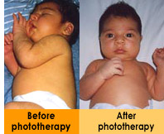

Slide 29
NJ - 29
Side effects of phototherapy
Increased insensible water loss
Loose stools
Skin rash
Bronze baby syndrome
Hyperthermia
Upsets maternal baby interaction
May result in hypocalcemia
Teaching Aids: NNF
Notes:
29

Slide 30
NJ - 30
Choice of blood for exchange blood transfusion
ABO incompatibility
Use O blood of same Rh type, ideal O cells suspended in AB plasma
Rh isoimmunization
Emergency 0 -ve blood Ideal 0 -ve suspended in AB plasma or baby's blood group but Rh -ve
Other situations
Baby's blood group
Teaching Aids: NNF
Notes:
30

Slide 31
DRUGS
Phenobarbitone- increases y&z ligandin receptors-induces liver enzymes-increases conjugation
Metalloporphyrins- tin&zinc-inhibits heme oxygenase
IVIG- inhibits heamolysis
Oral agar agar &cholestyramine- decreases entero hepatic circulation
Albumin infusions-increases bilirubin binding

Slide 32
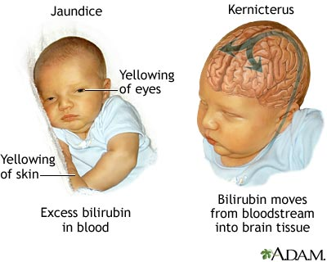
Kernicterus
Kernicterus is damage to the brain centers of infants caused by increased levels of unconjugated-indirect bilirubin which is free (not bound to albumin).

Slide 33
NJ - 33
Prolonged indirect jaundice
Causes
Crigler Najjar syndrome
Breast milk jaundice
Hypothyroidism
Pyloric stenosis
Ongoing hemolysis, malaria
Teaching Aids: NNF
Notes:
33

Slide 34
NJ - 34
Conjugated hyperbilirubinemia
Suspect
High colored urine
White or clay colored stool
Caution
Always refer to hospital for investigations so that biliary atresia or metabolic disorders can be diagnosed and managed early
Teaching Aids: NNF
Notes:
34

Slide 35
NJ - 35
Conjugated hyperbilirubinemia
Causes
Idiopathic neonatal hepatitis
Infections -Hepatitis B, TORCH, sepsis
Biliary atresia, choledochal cyst
Metabolic -Galactosemia, tyrosinemia, hypothyroidism
Total parenteral nutrition
Teaching Aids: NNF
Notes:
35

Slide 36
THANK YOU

